Slide 1
Empowering Smart Cities with AI & RPA
Presented By : Chetan B
USN : 4AL22IS402

Slide 2
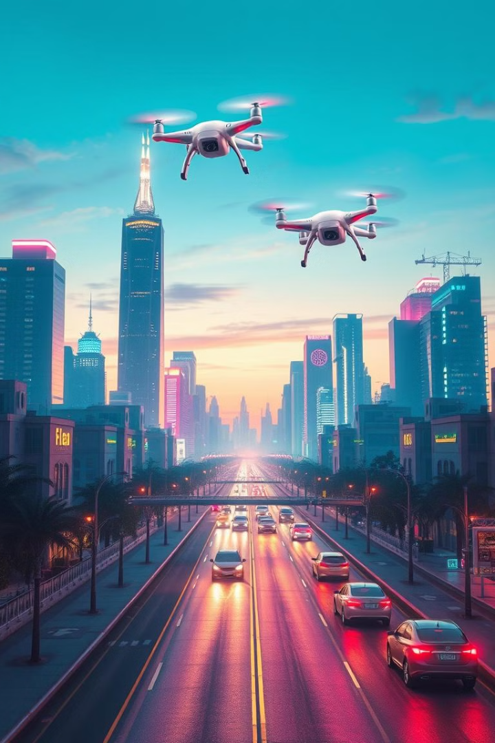
Empowering Smart Cities with AI & RPA
Revolutionizing urban landscapes through automation and intelligence. The AI and RPA market for smart cities is projected to reach $27.5 billion by 2028, with a CAGR of 25.7%. This presentation will cover challenges, solutions, examples, strategies, and future outlook.

Slide 3
Current Challenges in Urban Environments
Inefficient Resource Allocation
Traffic Congestion
Public Safety Concerns
Increased costs due to poor management of resources.
US cities lose $190 billion annually to wasted time and fuel.
Incident response times average 10 minutes, delaying assistance.
Aging infrastructure requires costly repairs, needing $4.6T over 10 years. Data silos hinder effective decision-making and citizen services.

Slide 4




AI & RPA Solutions for Smart Cities
AI-powered Traffic Management
RPA for Streamlined Processes
Real-time optimization reducing congestion by 20-30%.
Automating processes, reducing processing time by 50%.
AI for Predictive Policing
Analyzing crime patterns, reducing crime rates by 10-15%.
AI can drive energy management, reducing costs by 15-20%. RPA monitors infrastructure, cutting maintenance by 25%.

Slide 5




Real-World Examples of AI & RPA in Action
Barcelona, Spain
Singapore
Dubai, UAE
AI waste management reduces costs by 18%.
Smart traffic system reduces congestion by 25%.
RPA automates 80% of transactions, saving $1.2B.
New York City uses AI for predictive policing, cutting crime. Amsterdam optimizes energy, reducing emissions by 20%.

Slide 6




Implementing AI & RPA: A Strategic Approach
Assess
Identify key challenges and opportunities.
Pilot
Launch small-scale pilot projects ($100k-$500k).
Scale
Expand successful projects city-wide.
Integrate AI/RPA with existing systems. Train employees and prioritize data security.

Slide 7



The Future of Smart Cities: Transformation
Autonomous Vehicles
2
Reduce accidents by 90%.
Personalized Services
1
AI chatbots boost customer satisfaction.
Proactive Maintenance
3
AI reduces downtime by 60%.
Sustainable development cuts carbon by 30% by 2030. AI and RPA create livable, efficient, sustainable cities.

Slide 8

THANK YOU

